Slide 1
MVPCS MOCK GOVERNOR ELECTION
Grades 1–2 History & Social Science Unit
October 1 – November 3, 2026
LEARN
CAMPAIGN
VOTE
leaders • governor • democracy • voting
posters • flyers • speeches • voter guides
schoolwide mock election • tally • reflect
The classroom candidates are fictional and not connected to any real party or candidate.
Pillar connection: DEMOCRACY — listen, learn, make a fair choice, vote, accept the result, and keep working together.

Slide 2
Our Election Unit Timeline
Five weeks of civics learning, campaign education, and a schoolwide mock vote.
OCT. 1–2
OCT. 5–9
OCT. 12–16
OCT. 19–23
OCT. 26–30
NOV. 3
Leaders & community
→
The Massachusetts Governor
→
Democracy, elections & voting
→
Candidates, platforms & issues
→
Create campaigns
→
MOCK ELECTION DAY
Culminating event: Tuesday, November 3, 2026
This is also the date of the real Massachusetts state election in 2026.
Source: Massachusetts Secretary of the Commonwealth — Upcoming Elections (2026).

Slide 3
What Will We Learn?
By Election Day, students should be able to explain these ideas in their own words.
1. LEADERSHIP
2. GOVERNOR
3. ELECTIONS
Describe qualities of a helpful leader and explain that leaders have responsibilities to a group.
Name the Governor of Massachusetts and explain several jobs of the Governor.
Explain election, vote, ballot, candidate, campaign, platform, and issue.
4. DEMOCRACY
5. CIVIC ACTION
Connect voting, respectful listening, fairness, and accepting results to the MVPCS Pillar of Democracy.
Use accurate facts to create posters, flyers, speeches, and a voter guide for a fictional campaign.
Aligned to MA HSS Grade 1 Topic 1 standards on leadership, voting, elections, and elected leaders; extended through Grade 2 civics/government.

Slide 4
Key Vocabulary: People & Government
LEADER
GOVERNMENT
GOVERNOR
CITIZEN
A person who helps a group organize, decide, and work toward a goal.
The people and systems that make and carry out rules and laws.
The elected leader of a state’s executive branch.
A member of a country with rights and responsibilities.
Say it together:
“A governor is a leader in state government.”
Turn & talk: How is a governor like a classroom leader? How is the job different?

Slide 5
Key Vocabulary: Democracy & Voting
DEMOCRACY
ELECTION
VOTE
BALLOT
A system in which people have a voice in government, including by voting.
A kind of voting in which people select leaders.
To make a choice in an election or a group decision.
The paper or screen used to record a vote.
LEARN
THINK
CHOOSE
VOTE
RESPECT
Democracy is more than Election Day. It also includes listening, learning, and participating respectfully.

Slide 6
Key Vocabulary: Campaigns & Ideas
CANDIDATE
CAMPAIGN
PLATFORM
A person seeking to be chosen for an office.
Organized work to help people learn about and support a candidate or idea.
A candidate’s set of ideas and plans about important issues.
ISSUE
PERSUADE
FACT / OPINION
A topic or problem people care about and may disagree about.
To give reasons that may convince someone.
A fact can be checked; an opinion is a belief or judgment.

Slide 7
What Makes a Good Leader?
Massachusetts Grade 1 civics asks students to describe qualities of good leaders.
organized
caring
works for the common good
GOOD
LEADER
respectful
listens
responsible
honest
fair
A leader is still a member of the group — but has extra responsibility to help the group succeed.
MA HSS Grade 1 standards HSS.1.T1.03–04.

Slide 8
Leadership Check: What Would You Say?
Hold up 👍 for helpful leadership or ✋ for “needs a better choice.”
MIA
NOAH
LENA
Mia listens to everyone, then helps the group choose a plan.
Helpful leadership? Why?
Noah says, “Only my idea matters.”
Helpful leadership? Why or why not?
Lena gives jobs to group members and thanks them for helping.
Helpful leadership? Why?
Sentence starter: “I think this shows / does not show good leadership because…”

Slide 9
What Is State Government?
Massachusetts state government has three branches.
LEGISLATIVE
EXECUTIVE
JUDICIAL
Makes state laws.
Massachusetts Legislature = the General Court.
Carries out state laws.
The Governor leads this branch.
Courts decide legal questions and interpret laws.
Our unit focuses on the Governor — but the Governor does not run all three branches.
Source: Massachusetts Secretary of the Commonwealth — structure of state government.

Slide 10
What Does the Massachusetts Governor Do?
The Governor is the head of the executive branch of Massachusetts government.
CARRY OUT LAWS
BUDGET
APPOINT
Leads executive agencies that put state laws into action.
Prepares/proposes the annual state budget.
Appoints leaders of many state departments and agencies.
SIGN OR VETO
EMERGENCIES
REPRESENT THE STATE
Accepts or vetoes bills passed by the Legislature.
Helps coordinate the state response during emergencies.
Works with the federal government and others on behalf of Massachusetts.
Source: Massachusetts Secretary of the Commonwealth, State Constitutional Officers / Governor responsibilities.

Slide 11
Can the Governor Do That?
A governor is powerful — but does not make every decision alone.
GOVERNOR HAS A ROLE
LOCAL / SCHOOL DECISION
NEEDS MANY PARTS OF GOVERNMENT
Propose a state budget
Sign or veto a state bill
Appoint many department leaders
Help coordinate a statewide emergency
Choose your classroom snack
Set one class’s recess schedule
Pick your class read-aloud
Make every town’s daily schedule
Create a new law
Large housing programs
Major transportation projects
State-local climate and coastal work
Big idea: A campaign promise is not the same thing as having the power to act alone.

Slide 12
Who Is the Governor of Massachusetts?
Current office-holder to teach by name — verify again immediately before the lesson.
MAURA HEALEY
Governor of Massachusetts
As of September 2026
The Governor’s office is in the Massachusetts State House in Boston.
Student check: “Who is the Governor?” → “Governor Maura Healey.”
Source: Mass.gov Governor’s Office and Massachusetts Secretary of the Commonwealth.

Slide 13
The MVPCS Pillar: Democracy
Our mock election is practice in how a community can make fair choices together.
LISTEN
LEARN
CHOOSE
VOTE
RESPECT
Hear different ideas.
Use accurate facts.
Think about what matters to you.
Make one private choice.
Accept the result and keep working together.
Democracy does NOT mean everyone agrees. It means people have a voice and use fair processes to make shared decisions.

Slide 14
How Does an Election Work?
Put these steps in order.
1 LEARN about candidates and issues
2 THINK about the ideas
3 MARK one choice on the ballot
4 CAST the ballot
5 COUNT the ballots fairly
6 ACCEPT the result and continue participating
A secret ballot means your vote can stay private.

Slide 15
What Is a Campaign? What Is a Platform?
CAMPAIGN
PLATFORM
The organized work people do to help voters learn about a candidate and the candidate’s ideas.
Campaign tools: posters, flyers, speeches, questions, voter guides.
The candidate’s set of ideas and plans about important issues.
A fair campaign uses the official platform facts and does not invent promises.
Our goal is not to make everyone choose the same candidate. Our goal is to help voters understand both choices.

Slide 16
Issues Martha’s Vineyard Voters Might Care About
These are classroom topics for discussing what state leaders can influence.
COASTS & CLEAN WATER
TRANSPORTATION
SCHOOLS & YOUTH
beaches • dunes • ponds • storms
roads • crosswalks • buses • island connections
libraries • science • arts • recreation
YEAR-ROUND HOUSING
ENERGY & PREPAREDNESS
LOCAL JOBS
homes for families and year-round workers
energy saving • storms • outages
small businesses • workers • farms • fisheries
Teacher reminder: “Which level of government has a role?” is often as important as “Which idea do you like?”

Slide 17
Meet Fictional Candidate: Avery Shore
AVERY SHORE
Avery’s four platform topics
“Listen. Protect. Connect.”
Coasts & clean water
Safe transportation
Schools & libraries
Year-round housing
Avery Shore is a fictional Massachusetts community planner who grew up near the coast and likes solving problems by listening to many people before making a plan.
Fictional. Nonpartisan. Equal campaign time.

Slide 18
Avery Shore: Platform Details
COASTS & CLEAN WATER
SAFE TRANSPORTATION
Ask the state to invest more in beach, dune, pond, and coastal-restoration projects that help communities prepare for storms.
Prioritize state grants for safer roads, crosswalks, sidewalks, bike routes, and emergency transportation planning, including island communities.
SCHOOLS & LIBRARIES
YEAR-ROUND HOUSING
Propose state budget support for school libraries, science materials, arts programs, and field-learning opportunities.
Use state housing partnerships to support homes for teachers, nurses, firefighters, and other year-round workers in high-cost communities.

Slide 19
Meet Fictional Candidate: Jordan Fields
JORDAN FIELDS
Jordan’s four platform topics
“Strong Communities. Bright Futures.”
Energy & preparedness
Community transportation
After-school & recreation
Homes & local jobs
Jordan Fields is a fictional Massachusetts small-business owner and youth-sports volunteer who believes communities are strongest when families have useful services and safe places to live, learn, and play.
Fictional. Nonpartisan. Equal campaign time.

Slide 20
Jordan Fields: Platform Details
ENERGY & PREPAREDNESS
COMMUNITY TRANSPORTATION
Expand state help for energy-saving improvements in homes, schools, and public buildings, and improve storm and power-outage preparedness.
Support state investments in safer roads, public transportation connections, and cleaner vehicles that help people travel around Massachusetts.
AFTER-SCHOOL & RECREATION
HOMES & LOCAL JOBS
Propose state support for after-school learning, music, sports, parks, and safe community recreation programs.
Help communities repair or reuse existing buildings for year-round housing and support programs for local jobs and small businesses.

Slide 21
Compare the Fictional Candidates
Compare ideas — not personalities. There is no “teacher choice.”
Issue | Avery Shore | Jordan Fields
Environment / preparedness | Coastal restoration, clean water, storm prep | Energy-saving improvements, storm/outage prep
Transportation | Roads, crosswalks, sidewalks, bike routes, emergency planning | Roads, public transportation connections, cleaner vehicles
Schools / youth | Libraries, science, arts, field learning | After-school learning, music, sports, parks
Housing / community | Housing partnerships for year-round workers | Reuse/repair buildings for housing; local jobs
Issue
Avery Shore
Jordan Fields
Talk with a partner: What is one similarity? What is one difference?
Different voters may reasonably prioritize different issues.

Slide 22
Fact or Opinion?
Facts can be checked. Opinions tell what someone believes, prefers, or judges.
“Avery’s platform includes coastal-restoration projects.”
FACT
“Jordan’s platform includes after-school programs.”
FACT
“Transportation is the most important issue.”
OPINION
“Every voter should care most about beaches.”
OPINION
Campaign rule: You may use opinions — but you must not pretend an opinion is a fact.

Slide 23
Fair Campaign Rules
Both teams get the same time, materials, and display opportunities.
Use only accurate facts from the official fictional platform sheet.
Do not insult, threaten, pressure, or offer rewards for votes.
Do not use real party names, logos, slogans, or real 2026 campaign messages.
Explain what your candidate plans to do — do not call the other candidate “bad.”
Voters may keep their choice private.
After the count, both teams congratulate one another and clean up together.
Respect the voter’s right to choose differently.

Slide 24
Campaign Team Jobs
RESEARCHER / FACT-CHECKER
Find the exact platform fact and check accuracy.
ARTIST / DESIGNER
Make posters and flyers clear and easy to read.
SPEAKER
Practice the speech and answer questions using platform facts.
MATERIALS MANAGER
Keep supplies organized and help the team meet deadlines.
RESPECT MONITOR
Remind the team to disagree with ideas respectfully.

Slide 25
Build a Persuasive Poster or Flyer
A strong campaign product has five parts.
1
2
3
4
5
CANDIDATE NAME
SLOGAN
ONE ISSUE
ACCURATE PLATFORM FACT
REASON IT MATTERS
Before coloring or finalizing: FACT-CHECK!
Can a teammate point to the exact platform sentence that supports your claim?

Slide 26
Campaign Speech Sentence Starters
Grade 1 may use 4 sentence frames. Grade 2 can add two reasons and answer one question.
Hello, MVPCS! I am speaking for ____________________.
Our campaign slogan is “____________________.”
One issue we care about is ____________________.
The official platform says ____________________.
This matters to Martha’s Vineyard / Massachusetts because ____________________.
I think this idea would help by ____________________.
Please learn about both candidates and vote for the ideas that matter most to you.
Thank you for listening respectfully.

Slide 27
Campaign Forum: Fair Questions for Both Teams
Ask the same question to both campaigns and give equal response time.
What would your candidate focus on for schools or children?
What would your candidate do about the environment or storms?
What does your candidate say about transportation?
How would your candidate approach year-round housing or community needs?
Which platform idea does your team think matters most — and why?
Forum norm: answer with platform facts, not attacks.

Slide 28
Election Day: November 3, 2026
Schoolwide mock election procedures.
1
Learn about both candidates
2
Enter the polling place quietly
3
Mark ONE choice privately
4
Put the ballot in the ballot box
5
Receive an “I Voted” badge
6
Count with observers from both teams
7
Announce the result respectfully
8
Reflect: What made the election fair?
No campaigning at the voting table. Voters should be able to choose privately and without pressure.
The real Massachusetts state election is also November 3, 2026. The classroom ballot is fictional.

Slide 29
After the Vote: Democracy Continues
The result is the end of the campaign — not the end of the community.
CONGRATULATE
REFLECT
KEEP WORKING TOGETHER
Both teams thank one another for helping voters learn about the issues.
What made the election fair? What did you learn about the Governor’s job?
People can make different choices and still be one school community.
“I heard an idea I disagreed with. I showed respect by…”

Slide 30
Massachusetts Standards Connection
The strongest match is Grade 1 Topic 1: Civics — communities, elections, and leadership.
HSS.1.T1.03
A leader is a group member with extra responsibility.
HSS.1.T1.04
Describe qualities of good leaders.
HSS.1.T1.05
Explain how voting can make fair decisions or choose leaders.
HSS.1.T1.06
Explain that an election is voting to select leaders.
HSS.1.T1.07
Identify elected leaders, including the Governor of Massachusetts, and explain their roles.
HSS.1.T1.08
Citizens elect leaders and pay attention to how they serve.
HSS.2.T4.02
Grade 2 extension: countries have governments, leaders, citizens, and purposes such as education and security.
Source: Massachusetts DESE 2018 History and Social Science Curriculum Framework / Standards Navigator.

Slide 31
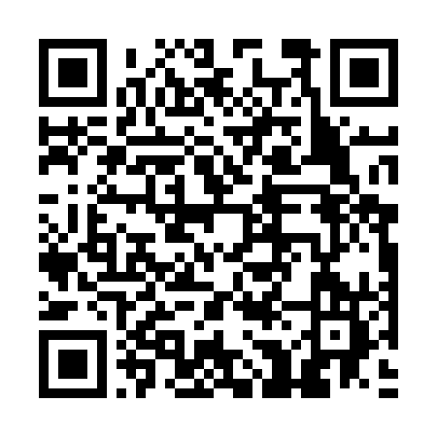
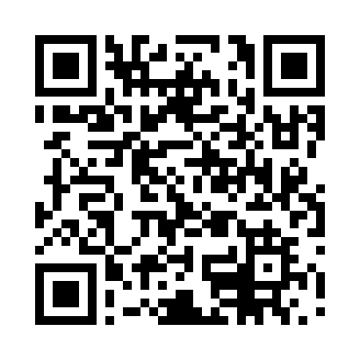
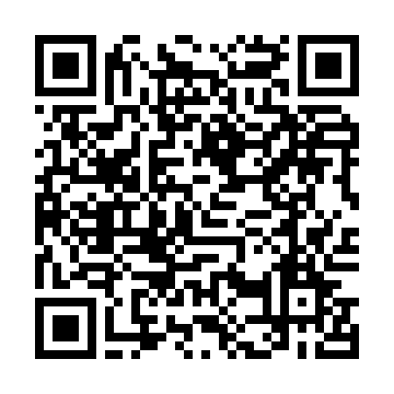
Teacher Resources: Videos, Websites & Read-Alouds
Use the QR codes in the Teacher Guide for quick access.
MA KIDS’ ZONE
PBS KIDS
GPB EDUCATION
Governor’s Office and State House information from the Massachusetts Secretary of the Commonwealth.
“Together We Can: Election” — short early-elementary voting video.
“What Does a Governor Do?” — public-media explainer; compare Georgia examples with Massachusetts.
Read-alouds in the Teacher Guide: Duck for President • Grace for President • Vote for Our Future!
The Teacher Guide contains clickable source links, lesson plans, answer keys, differentiation, and Election Day setup.

