Slide 1


Our Mock Governor Election
October 1 to November 3
Leadership, state government, campaigns, and the MVPCS pillar of Democracy
Notes:
Opening question: What do you notice about the community behind the candidates? Explain that Avery Harbor and Jordan Woods are fictional. No real party or candidate is represented.

Slide 2
UNIT OVERVIEW
Our learning journey
1
2
3
4
5
LEADERS
GOVERNOR
PLATFORMS
CAMPAIGNS
VOTE
What qualities help a group?
What can a state governor do?
What problems will each candidate address?
How do facts and reasons persuade?
How does a fair election work?
MVPCS Grades 1-2 | Fictional candidates | Democracy
2
MVPCS MOCK GOVERNOR ELECTION
2
Notes:
Preview the five stages. Ask students which stage they are most curious about.

Slide 3
MVPCS PILLAR
Democracy gives people a voice
A voice
A fair choice
Respect
People share ideas and explain what matters to them.
Voters hear the same information and receive one private ballot.
People may choose differently and still belong to one community.
Turn and talk
When has our class made a decision together? What made the decision fair?
MVPCS Grades 1-2 | Fictional candidates | Democracy
3
MVPCS MOCK GOVERNOR ELECTION
3
Notes:
Connect directly to the MVPCS Democracy pillar. Invite examples such as class meetings, group choices, or voting between two activities.

Slide 4
LEADER QUALITIES
Leadership means responsibility
LISTENS
HONEST
FAIR
hears people before deciding
uses facts and admits mistakes
uses the same rules for everyone
CARING
BRAVE
COOPERATES
thinks about who may need help
makes a hard choice for the common good
works with other people
Which quality would be hardest for a leader? Explain your thinking.
MVPCS Grades 1-2 | Fictional candidates | Democracy
4
MVPCS MOCK GOVERNOR ELECTION
4
Notes:
Students select one quality and give an example. Standard 1.T1.4 asks students to describe qualities of a good leader and acting for the common good.

Slide 5
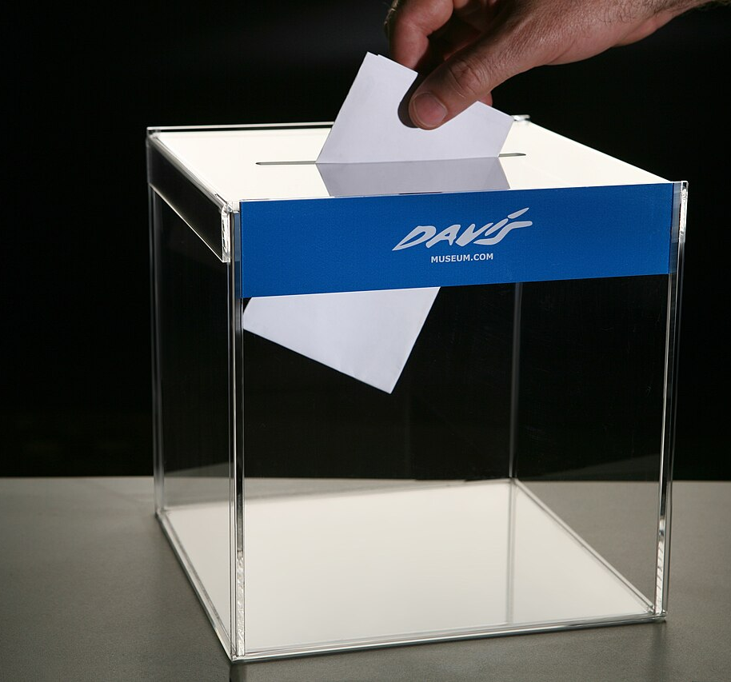
VOCABULARY
Election words we will use
candidate
a person asking voters to choose them
campaign
organized work to help a candidate
platform
the plans and ideas a candidate supports
ballot
the paper or form used to record a vote
voter
a person who casts a vote
election
voting to choose a leader
MVPCS Grades 1-2 | Fictional candidates | Democracy
5
MVPCS MOCK GOVERNOR ELECTION
5
Notes:
Act out each word. Point out that a secret ballot protects a voter’s private choice. Image source: Wikimedia Commons, Ballot-box-2.jpg, CC BY-SA.

Slide 6
ELECTION PROCESS
A fair election follows clear steps
1
2
3
4
5
LEARN
LISTEN
THINK
VOTE
COUNT
Study each candidate’s platform.
Hear speeches and ask questions.
Compare ideas with your priorities.
Mark one choice in private.
Check every ballot carefully.
Fairness check: one voter, one ballot, one private choice
MVPCS Grades 1-2 | Fictional candidates | Democracy
6
MVPCS MOCK GOVERNOR ELECTION
6
Notes:
Use a hand signal for each step. Ask what could go wrong if a step were skipped.

Slide 7
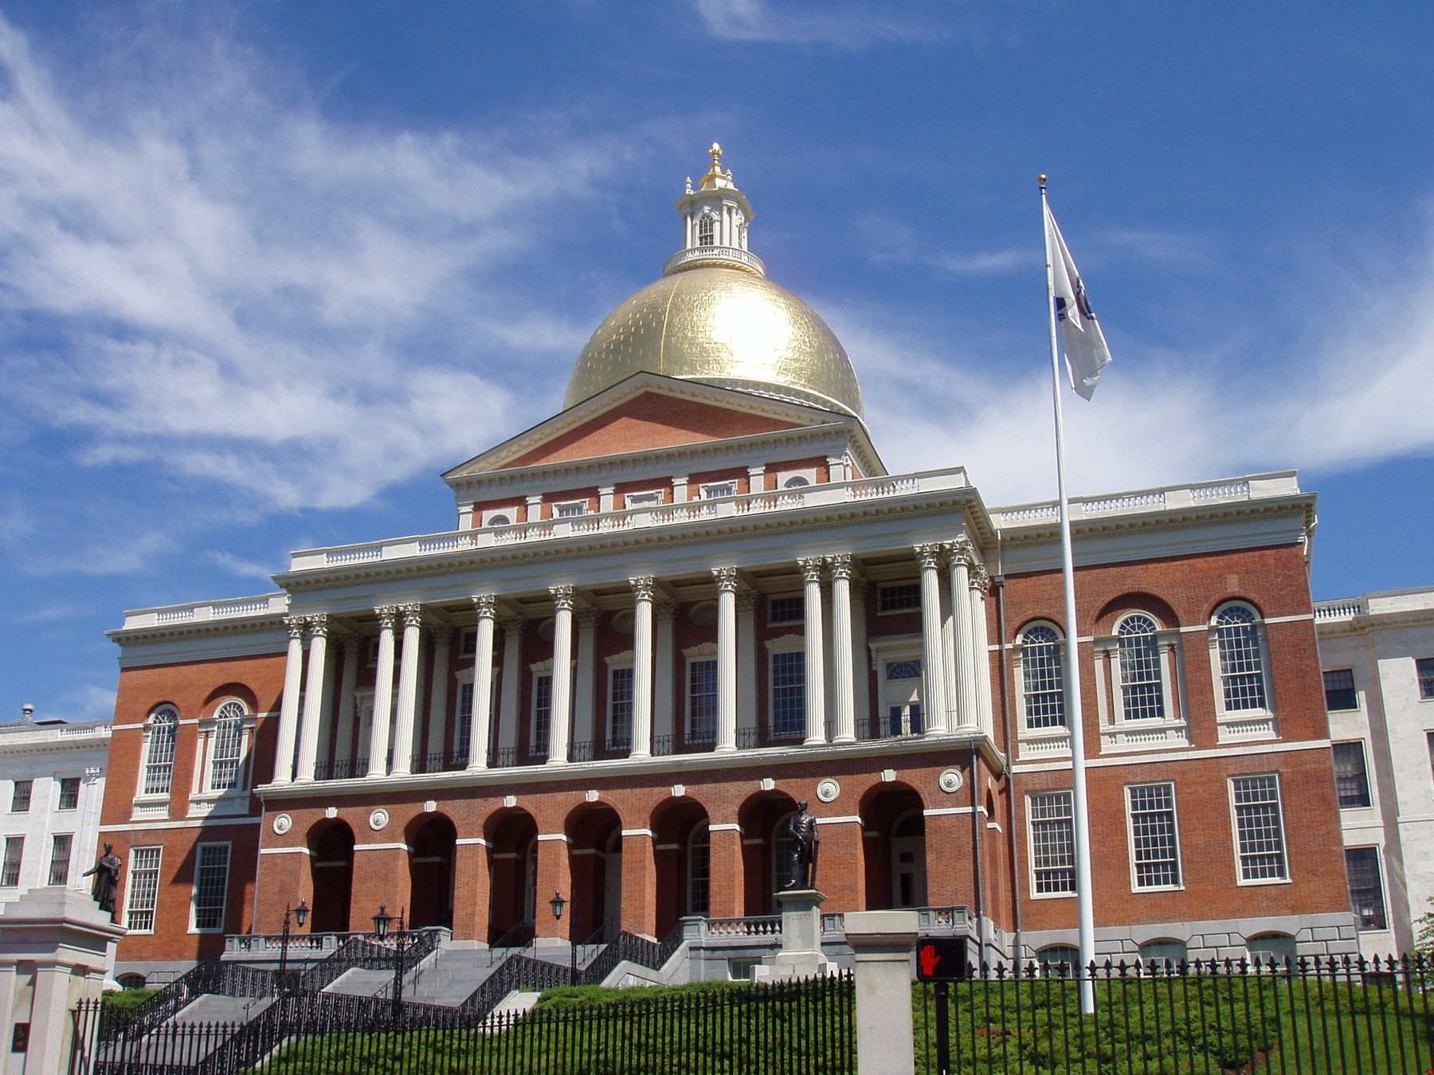
PLACE AND GOVERNMENT
Massachusetts is our state
State capital
Boston
Our island county
Dukes County
Our community
Martha’s Vineyard
State leaders make choices that affect communities across Massachusetts.
MVPCS Grades 1-2 | Fictional candidates | Democracy
7
MVPCS MOCK GOVERNOR ELECTION
7
Notes:
Locate Boston and Martha’s Vineyard on a classroom map. The State House is where the governor and Legislature work. Photo: Massachusetts State House, Wikimedia Commons.

Slide 8
CURRENT OFFICEHOLDER
Governor Maura Healey
73rd Governor of Massachusetts
Governor Healey took office in January 2023.
GOVERNOR’S SEAL
Executive branch
She leads the part of state government that carries out laws.
Lieutenant governor
Kim Driscoll serves as Lieutenant Governor and works with the governor.
MVPCS Grades 1-2 | Fictional candidates | Democracy
8
MVPCS MOCK GOVERNOR ELECTION
8
Notes:
Students repeat: Maura Healey is the Governor of Massachusetts. This identification is factual, not an invitation to evaluate a real official. Source: mass.gov official governor page, accessed September 2026.

Slide 9
MASSACHUSETTS GOVERNMENT
Three branches share power
LEGISLATIVE
EXECUTIVE
JUDICIAL
The House and Senate discuss bills and vote on laws.
The governor and state agencies carry out laws.
Courts explain laws and decide cases.
No branch controls every decision. They have different jobs.
MVPCS Grades 1-2 | Fictional candidates | Democracy
9
MVPCS MOCK GOVERNOR ELECTION
9
Notes:
Have three student groups act out the branches. Keep the focus on job differences, not complex checks and balances vocabulary.

Slide 10

ROLE OF THE GOVERNOR
The governor’s main responsibilities
LEADS AGENCIES
PROPOSES A BUDGET
Helps state departments carry out laws and serve people.
Recommends how Massachusetts should collect and spend money.
ACTS ON BILLS
APPOINTS OFFICIALS
Signs a bill into law or returns it with a veto.
Chooses certain judges and agency leaders, often with approval.
RESPONDS TO EMERGENCIES
REPRESENTS THE STATE
Coordinates state help during storms and other emergencies.
Works with local, tribal, regional, and federal leaders.
MVPCS Grades 1-2 | Fictional candidates | Democracy
10
MVPCS MOCK GOVERNOR ELECTION
10
Notes:
Official role sources: Massachusetts Secretary of the Commonwealth, State Constitutional Officers and Politics, Counties, and Municipalities.

Slide 11

GOVERNOR ROLE 1
A state budget is a plan for money
The governor proposes
The Legislature studies it
State agencies use approved funds
a spending plan
and makes decisions
to provide services
Island example
A governor could propose money for clean-water testing, school programs, housing, or safer transportation. The Legislature must approve state spending.
MVPCS Grades 1-2 | Fictional candidates | Democracy
11
MVPCS MOCK GOVERNOR ELECTION
11
Notes:
Clarify: a campaign promise involving state money still requires a budget process and legislative approval.

Slide 12

GOVERNOR ROLE 2
The governor signs or vetoes bills
1
2
3
4
BILL
›
VOTE
›
GOVERNOR
›
LAW OR RETURN
A legislator proposes an idea.
The House and Senate discuss and vote.
The governor may sign or veto the bill.
A signed bill becomes law. A veto returns it.
MVPCS Grades 1-2 | Fictional candidates | Democracy
12
MVPCS MOCK GOVERNOR ELECTION
12
Notes:
A veto does not mean “bad.” It means the governor does not approve that bill as written. Keep the explanation simple for Grades 1 and 2.

Slide 13
GOVERNOR ROLE 3
State agencies turn laws into services
Transportation
Education
roads, buses, safety grants
state guidance and school funding
Environment
Public health
water, air, habitats, waste
health programs and emergency planning
The governor leads the executive branch. Agency workers do much of the daily work.
MVPCS Grades 1-2 | Fictional candidates | Democracy
13
MVPCS MOCK GOVERNOR ELECTION
13
Notes:
Ask: Which agency might help with a polluted pond? Which might help with a dangerous road crossing?

Slide 14
GOVERNOR ROLE 4
Emergency leadership requires teamwork
Coastal storm example
Governor
coordinates state action
Emergency agencies
move supplies and share warnings
Towns and tribal government
open shelters and identify local needs
Utility and transportation teams
restore connections and essential services
One leader coordinates. Many people carry out the response.
MVPCS Grades 1-2 | Fictional candidates | Democracy
14
MVPCS MOCK GOVERNOR ELECTION
14
Notes:
Connect to island storms without using frightening details. Emphasize preparation, communication, and cooperation.

Slide 15
INTERACTIVE SORT
What can a governor do?
CAN
CANNOT DO ALONE
propose a state budget
decide a court case
sign or veto a bill
make every school rule
lead state agencies
spend money without approval
coordinate state emergency help
choose how people vote
Point left or right. Then explain your reason.
MVPCS Grades 1-2 | Fictional candidates | Democracy
15
MVPCS MOCK GOVERNOR ELECTION
15
Notes:
Correct sort: first four CAN; final four CANNOT DO ALONE. Let students explain before revealing answers in discussion.

Slide 16
MOCK ELECTION
Two fictional candidates
AVERY HARBOR
JORDAN WOODS
No parties. Equal time. Different priorities.
MVPCS Grades 1-2 | Fictional candidates | Democracy
16
MVPCS MOCK GOVERNOR ELECTION
16
Notes:
Re-state that both candidates are invented. Assign equal speaking time, materials, adult help, and wall space.

Slide 17
FICTIONAL CANDIDATE
Avery Harbor’s platform
Protect island life and prepare for the future
Clean ocean and ponds
Storm preparation
Safer walking and biking
Outdoor classrooms
MVPCS Grades 1-2 | Fictional candidates | Democracy
17
MVPCS MOCK GOVERNOR ELECTION
17
Notes:
Generated illustration of a fictional candidate. Ask students to name the island details they see and connect them to Avery’s four priorities.

Slide 18
PLATFORM DETAILS
Avery’s plans use governor language
PROBLEM
PLAN
WHO HELPS
Polluted ponds
Propose state help for water testing
Environmental agencies and towns
Coastal storms
Coordinate supplies and shelter support
Emergency agencies and local leaders
Unsafe routes
Propose transportation safety grants
State transportation staff and towns
Need for outdoor learning
Propose school habitat grants
Education and conservation agencies
MVPCS Grades 1-2 | Fictional candidates | Democracy
18
MVPCS MOCK GOVERNOR ELECTION
18
Notes:
Model the distinction between “will fix” and “will propose or coordinate.” Students choose one row for a campaign product.

Slide 19
FICTIONAL CANDIDATE
Jordan Woods’s platform
Help island communities stay strong all year
Schools and libraries
Homes for workers
Local food and school meals
Reliable island connections
MVPCS Grades 1-2 | Fictional candidates | Democracy
19
MVPCS MOCK GOVERNOR ELECTION
19
Notes:
Generated illustration of a fictional candidate. Ask students to identify how the picture shows Jordan’s four priorities.

Slide 20
PLATFORM DETAILS
Jordan’s plans use governor language
PROBLEM
PLAN
WHO HELPS
Schools need resources
Propose funds for books, arts, and support
Education agency, Legislature, schools
Workers need homes
Propose housing programs
Housing agency, Legislature, towns
Local farms need support
Propose farm and school-meal grants
Agriculture and education agencies
Island travel can be difficult
Support transportation planning and funds
State, regional, and local authorities
MVPCS Grades 1-2 | Fictional candidates | Democracy
20
MVPCS MOCK GOVERNOR ELECTION
20
Notes:
The Steamship Authority has its own governing structure. Teach that a governor may support state planning and funding while working with regional and local authorities.

Slide 21
VOTER THINKING
Comparing priorities
AVERY HARBOR
JORDAN WOODS
Environmental preparation
Year-round community
water quality, storms, routes, outdoor learning
schools, homes, food, island connections
Neither platform is the “correct” answer.
A voter decides which priorities and plans best match what matters to that voter.
MVPCS Grades 1-2 | Fictional candidates | Democracy
21
MVPCS MOCK GOVERNOR ELECTION
21
Notes:
Do not poll students publicly on this slide. Have them write one question for each candidate.

Slide 22
FACT AND OPINION
Facts can be checked
FACT
OPINION
Maura Healey is the Governor of Massachusetts.
A governor may sign or veto a bill.
Avery and Jordan are fictional.
Clean water should come first.
School funding matters most.
One candidate has the better platform.
Campaigns may use opinions, but they must not disguise opinions as facts.
MVPCS Grades 1-2 | Fictional candidates | Democracy
22
MVPCS MOCK GOVERNOR ELECTION
22
Notes:
Read each sentence and ask how students know whether it can be checked.

Slide 23
POSTERS AND FLYERS
A truthful campaign message
NAME
PLAN
REASON
PICTURE
CHECK
Make the candidate easy to identify.
Choose one accurate platform idea.
Explain why the plan matters.
Match the image to the message.
Use respectful words and verify every claim.
✓
✓
✓
✓
✓
Fact checker question: Could a governor really propose, support, or coordinate this?
MVPCS Grades 1-2 | Fictional candidates | Democracy
23
MVPCS MOCK GOVERNOR ELECTION
23
Notes:
Use the Campaign Pack checklist before any poster or flyer is displayed.

Slide 24
PERSUASIVE SPEAKING
Campaign speech builder
OPENING
We support ___ because...
PROBLEM
We notice that...
PLAN
Our candidate would propose...
REASON
This matters because...
PARTNERS
The governor would work with...
CLOSING
Please consider ___ if you also care about...
MVPCS Grades 1-2 | Fictional candidates | Democracy
24
MVPCS MOCK GOVERNOR ELECTION
24
Notes:
Grade 1 may dictate or echo-read. Grade 2 should add a second supporting reason. Keep candidate speeches equal in length and practice time.

Slide 25
CANDIDATE FORUM
Questions for both candidates
1
What problem would you work on first?
2
Why does it matter to children and families?
3
What can a governor actually do?
4
Who would need to work with the governor?
5
How would you listen to people who disagree?
6
Which leadership quality would guide you?
MVPCS Grades 1-2 | Fictional candidates | Democracy
25
MVPCS MOCK GOVERNOR ELECTION
25
Notes:
Ask the same questions and allow the same response time for each candidate. Alternate which candidate answers first.

Slide 26
NOVEMBER 3
Election Day at MVPCS
Check in Receive one ballot Vote privately Place it in the box Count together
MVPCS Grades 1-2 | Fictional candidates | Democracy
26
MVPCS MOCK GOVERNOR ELECTION
26
Notes:
Generated classroom illustration. Walk students through each station. Correct the picture if needed: our real ballot will name Avery Harbor and Jordan Woods, not animal symbols.

Slide 27
BALLOT AND COUNT
One ballot, one private choice
OFFICIAL FICTIONAL BALLOT
Election workers
Protect privacy.
Count every valid ballot with a partner.
Check that totals match the number of ballots cast.
Choose one
Avery Harbor
Jordan Woods
A blank or unclear ballot is recorded separately. Never guess a voter’s choice.
MVPCS Grades 1-2 | Fictional candidates | Democracy
27
MVPCS MOCK GOVERNOR ELECTION
27
Notes:
Use the printable ballot in the Campaign Pack. Two adults or mixed-team election workers should verify the count.

Slide 28
REFLECTION
Democracy continues after the vote
WINNING TEAM
OTHER TEAM
Thank every voter. Remember that the governor serves everyone, including people who chose differently.
Respect the result. Be proud that your campaign helped people understand an issue.
How did we use facts, fairness, privacy, and respect?
How can both teams help our school tomorrow?
MVPCS Grades 1-2 | Fictional candidates | Democracy
28
MVPCS MOCK GOVERNOR ELECTION
28
Notes:
undefined
Sources for factual slides: Massachusetts DESE History and Social Science Framework (2018), https://www.doe.mass.edu/frameworks/hss/2018-12.pdf; Governor Healey and Lt. Governor Driscoll, https://www.mass.gov/orgs/governor-maura-healey-and-lt-governor-kim-driscoll; State Constitutional Officers, https://www.sec.state.ma.us/divisions/cis/government/constitutional-officers.htm; Massachusetts Government Structure, https://www.sec.state.ma.us/divisions/cis/government/politics-counties.htm.

Slide 29
MASSACHUSETTS CIVIC IDENTITY
Symbols of the Commonwealth
STATE FLAG
GREAT SEAL
GOLDEN DOME
White field with the coat of arms. The present form dates to 1971.
An official emblem used on government documents and buildings.
The State House dome is a familiar symbol of Massachusetts government.
Official state colors: blue, green, and cranberry. This deck also uses gold to represent the State House dome.
MVPCS MOCK GOVERNOR ELECTION
29
Notes:
The current flag, seal, and motto have been under formal review. Present these as the current official symbols, not as permanent or universally accepted imagery. Sources: Massachusetts Secretary of the Commonwealth, Concise Facts; Mass.gov Seal, Flag, and Motto Advisory Commission.

Slide 30
SYMBOLS CHANGE AND CARRY HISTORY
The Massachusetts motto
Ense petit placidam sub libertate quietem
“By the sword we seek peace, but peace only under liberty.”
The arrow on the current coat of arms points downward as a sign of peace. The star marks Massachusetts as one of the original states.
People are also discussing how the seal and motto represent Indigenous people. State symbols can be studied, questioned, and changed through government.
MVPCS MOCK GOVERNOR ELECTION
30
Notes:
Keep the historical discussion short and respectful for Grades 1 and 2. The motto translation and symbol descriptions come from official Massachusetts sources. Avoid presenting the seal’s imagery as Wampanoag-created or as representing all Indigenous people.

Slide 31
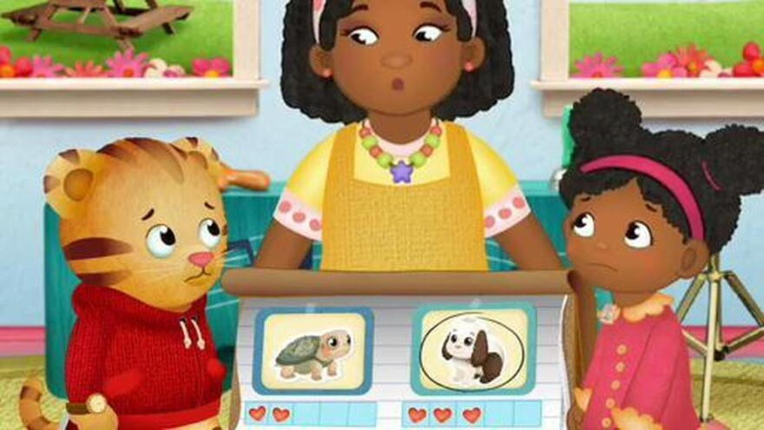
WATCH, NOTICE, DISCUSS
Video stop: voting in a neighborhood
▶ WATCH THE PBS VOTING CLIP
Before watching
What choice will the voters make?
During the clip
Notice the ballot, the choices, and how the vote stays fair.
After watching
How is their vote like our mock election?
MVPCS MOCK GOVERNOR ELECTION
31
Notes:
Click the cranberry button during Slide Show mode. Preview the clip before class. PBS LearningMedia may require a free educator login or station selection. Image is a promotional still from the Daniel Tiger voting episode.

Slide 32
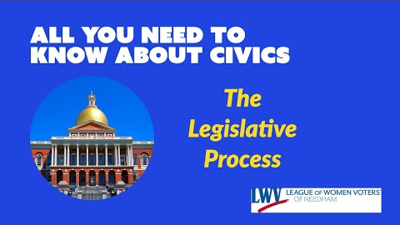
GOVERNOR AND LEGISLATURE
Video stop: how a Massachusetts bill becomes law
▶ WATCH THE MASSACHUSETTS PROCESS VIDEO
Teacher preview
The full video uses vocabulary above the Grade 1-2 level. Use a short selected section.
Listening focus
Who discusses and votes on a bill? What choice does the governor make?
LEGISLATURE VOTES + GOVERNOR ACTS
MVPCS MOCK GOVERNOR ELECTION
32
Notes:
Click the cranberry button during Slide Show mode. This video was created by Beacon Bloc and explains the Massachusetts legislative process. Use only a brief excerpt for young learners.

Slide 33
VIRTUAL FIELD TRIP
Explore the Massachusetts State House
Look for
★ the golden dome
★ the House chamber
★ the Senate chamber
★ the governor’s office
★ Massachusetts symbols
▶ OPEN THE OFFICIAL VIRTUAL TOUR
MVPCS MOCK GOVERNOR ELECTION
33
Notes:
undefined
Sources: https://www.sec.state.ma.us/divisions/cis/ciskid/kid-facts/concise-facts2.htm; https://www.sec.state.ma.us/divisions/public-records/history-of-seal.htm; https://www.mass.gov/info-details/massachusetts-state-seal; https://www.mass.gov/info-details/seal-flag-and-motto-round-three-selections.

