Slide 1
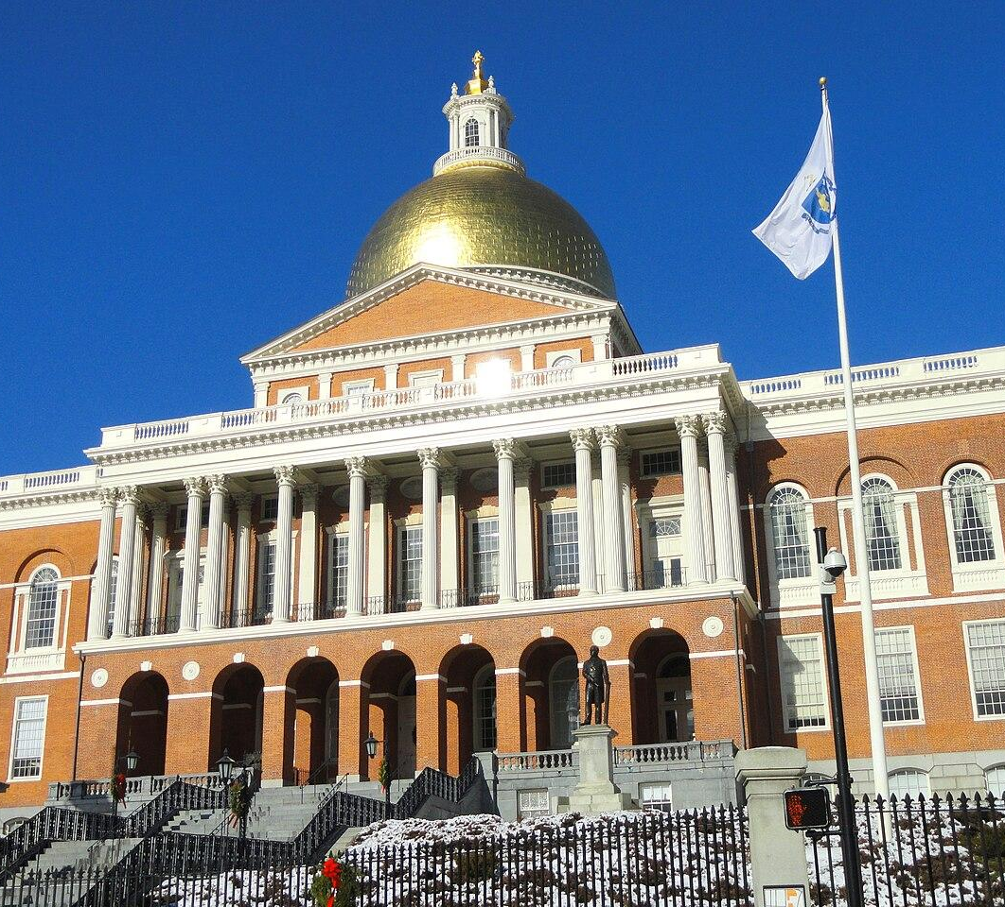
MASSACHUSETTS / GRADE 3
INSIDE THE
GOLDEN
DOME
An area investigation
through real places and objects
FIELD NOTES / FIVE STATIONS
INSIDE THE GOLDEN DOME
01
Notes:
Launch after students begin the do-now. Exterior photo: Daderot, Wikimedia Commons, CC0, https://commons.wikimedia.org/wiki/File:Massachusetts_State_House_-_Boston,_MA_-_DSC04664.JPG . Building history: https://www.sec.state.ma.us/divisions/state-house-tours/trsbok/trstour.htm

Slide 2
DO NOW / PACKET PAGE 1 / 5 MINUTES
ELECTION MORNING
1. Blue: 9 rows of 9.
What is the area?
2. The whole grid has 100 squares.
What area is white?
The news says “81% reporting.”
What does that describe?
100 equal square units
INSIDE THE GOLDEN DOME
02
Notes:
Students work independently on page 1. Expected answers: blue 9 × 9 = 81 and white 100 − 81 = 19 square units. Explain percentages as parts out of 100 without requiring a separate percent lesson. This is a model of the reporting percentage, not 100 actual ballots. Teacher-supplied news screenshot, 6:49 a.m., November 4, 2026. Reelection reporting: https://www.wbur.org/news/2026/11/03/massachusetts-healey-governor-race-election-result

Slide 3
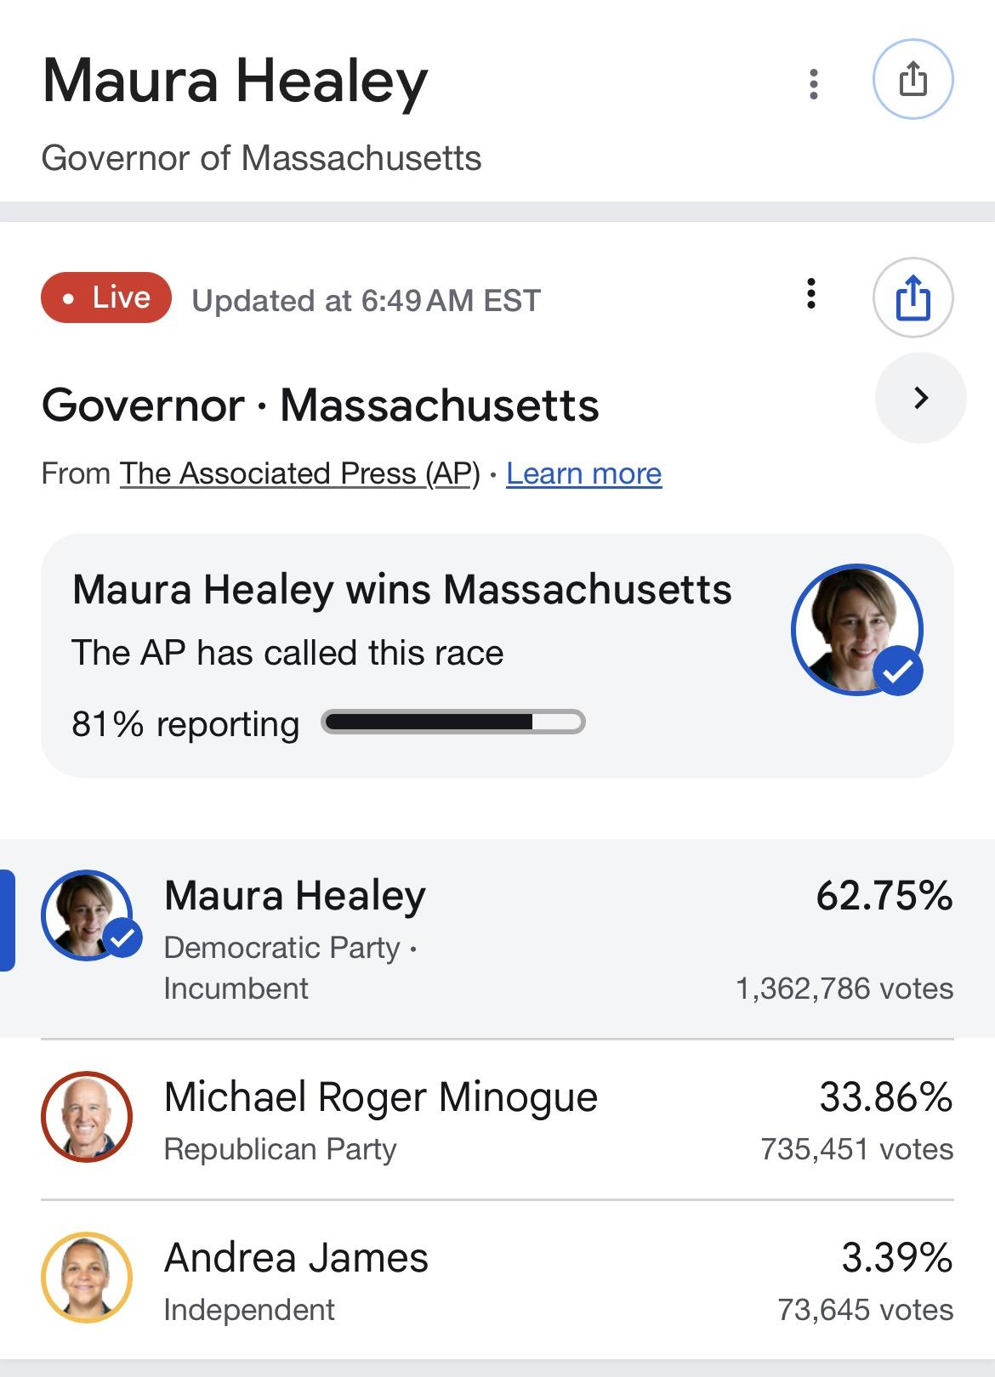
A NEWS SNAPSHOT / NOVEMBER 4, 2026
HEALEY WINS
81%
reporting at that moment
62.75%
Healey’s vote share in this snapshot
INSIDE THE GOLDEN DOME
03
Notes:
Read “81% reporting” precisely. Do not say she won 81% of the vote. The screenshot is interim and is not a certified final result. AP called the race. Teacher-supplied news screenshot, 6:49 a.m., November 4, 2026. Reelection reporting: https://www.wbur.org/news/2026/11/03/massachusetts-healey-governor-race-election-result

Slide 4
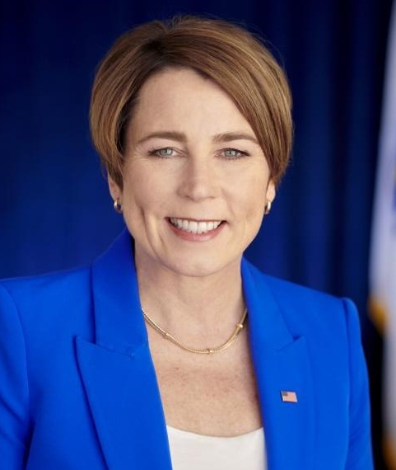
THE PERSON BEHIND THE TITLE
MAURA
HEALEY
The oldest of five children
Her mother was a school nurse.
Her stepfather was a teacher
and basketball coach.
She lives in Arlington with her
partner, Joanna, and their family.
Which two sides give this photo’s area?
INSIDE THE GOLDEN DOME
04
Notes:
Public, age-appropriate family information. Joanna Lydgate is described as her partner. Avoid private-life speculation or asking students to compare their own family arrangements. Bio and portrait: https://www.nga.org/governor/maura-healy/ ; https://massgovernor.substack.com/about Ask students which side lengths they would measure to find the area of a rectangular photo print.

Slide 5
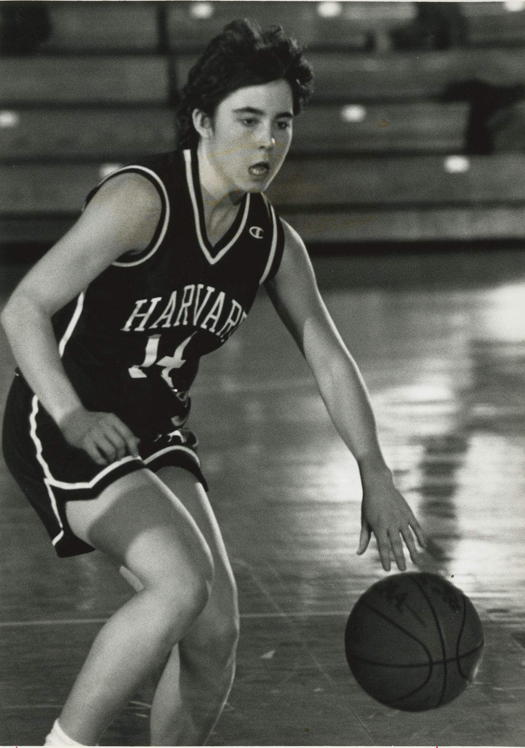
BASKETBALL IS PART OF HER STORY
HARVARD’S
NUMBER 14
Healey co-captained Harvard’s team.
Then she played professionally
in Austria for two years.
What makes a square unit useful
for measuring a basketball court?
05
INSIDE THE GOLDEN DOME
05
INSIDE THE GOLDEN DOME
Notes:
Harvard identifies Healey as a 1991–92 co-captain and jersey 14. Do not invent personal playing statistics. https://gocrimson.com/news/2023/1/31/general-gov-healey-92-discusses-journey-womens-athletics-with-mcdermott ; https://gocrimson.com/sports/womens-basketball/roster/maura-healey/20693 . Basketball image: Harvard University, published by The Boston Globe, https://www.bostonglobe.com/lifestyle/names/2016/07/01/attorney-general-maura-healey-pays-tribute-pat-summitt/lEZFrhyM1KRtNb6nwcba1L/story.html

Slide 6
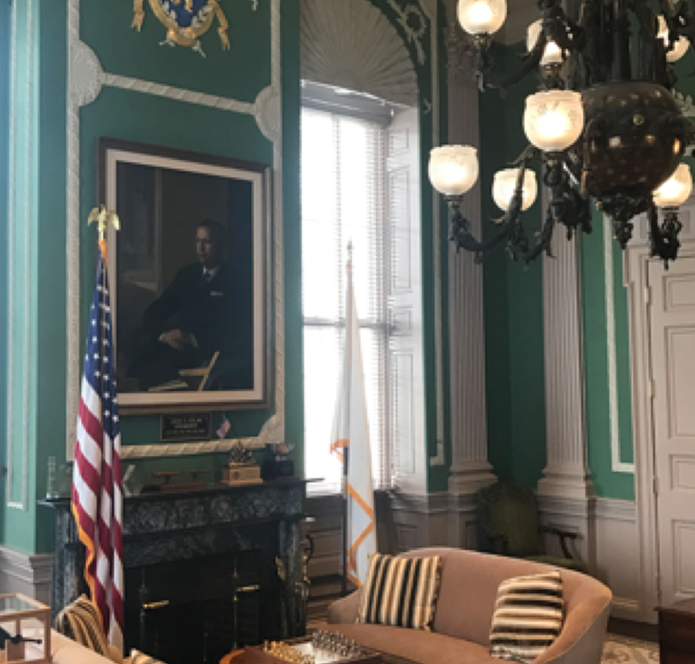
INSIDE A WORKING OFFICE
THE GOVERNOR’S
OFFICE
The governor works in
the State House.
Which objects in this
photograph have
rectangular faces?
How would you find
the area of one?
INSIDE THE GOLDEN DOME
06
Notes:
Point to the rectangular painting, table surfaces, door panels, or window panes. Ask what measurements would be needed. Do not infer actual object dimensions from the perspective photograph. Official interior photo: https://www.sec.state.ma.us/divisions/state-house-tours/information/interior-photos.htm .

Slide 7
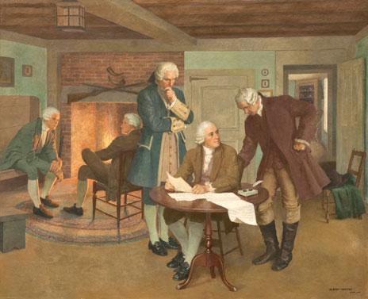
THE RULES FOR STATE GOVERNMENT
JOHN ADAMS AND THE CONSTITUTION
John Adams was the main writer
of the Massachusetts Constitution
of 1780.
This House chamber mural shows
Adams working with Samuel Adams
and James Bowdoin.
At Station 3: how much display mat
will show around the document?
INSIDE THE GOLDEN DOME
07
Notes:
Albert Herter painted the mural in 1942. Official image and catalogue: https://malegislature.gov/VirtualTour/FloorView?floorId=3 . The Constitution manuscript reproduction on Mat 3 comes from the Commonwealth Museum: https://www.sec.state.ma.us/divisions/commonwealth-museum/exhibits/treasures/constitution.htm. The original manuscript is not claimed to be in the State House. This painting is a later representation of the drafting work.

Slide 8
OUR MEASUREMENT TOOLKIT
HOW MUCH FLAT SPACE?
RECTANGLE
IRREGULAR OUTLINE
length × width
Use square units.
Count full squares.
Combine pieces along the edges.
BORDER
SCALE
outside area − opening area
A small length can stand
for a larger real length.
INSIDE THE GOLDEN DOME
08
Notes:
Give a one-minute reminder; students already know basic area. Demonstrate pairing two half-covered grid cells if needed. Rulers measure side lengths; area uses square units. The court mat includes a scale tile. The map has no real-world scale.

Slide 9
FIVE GROUPS / FIVE INVESTIGATIONS
YOUR STATION ROUTE
01
Massachusetts flags
8 MINUTES
02
The governor’s game
Read the exhibit.
Use the measuring mat.
Write in your own packet.
03
John Adams’s Constitution
04
The Sacred Cod
05
At the signal, move to
the next station number.
After 5, return to 1.
Blueprint detectives
INSIDE THE GOLDEN DOME
09
Notes:
Groups A/B/C/D/E start at stations 1/2/3/4/5. Suggested sizes: 3,3,3,3,2. Rotate Reader, Measurer, Checker roles. Pair combines Reader and Checker. Five rounds of eight minutes; allow one minute between rounds. Read each station preview briefly, then return to slide 16 during work.

Slide 10
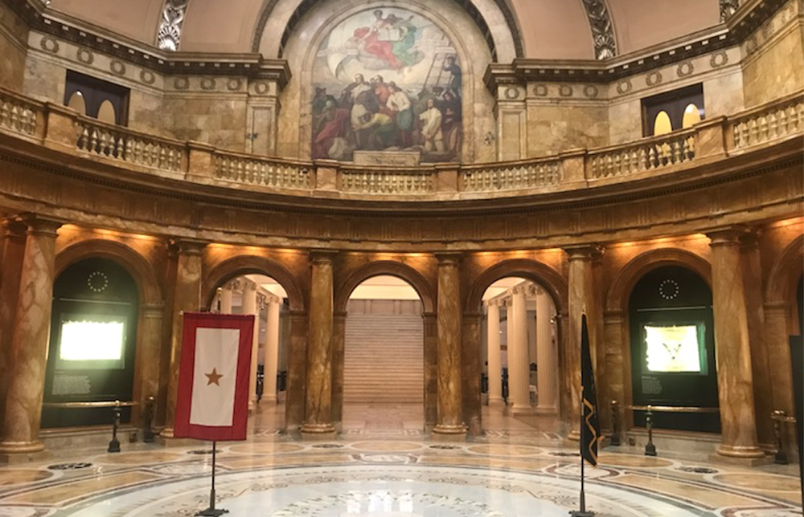
STATION 01 / PACKET PAGE 2
FLAGS WORTH A CLOSER LOOK
1
Estimate the large flag print’s area.
2
Measure both flag rectangles. Find their areas.
3
Compare the areas when both side lengths double.
Memorial Hall honors military service.
INSIDE THE GOLDEN DOME
10
Notes:
Memorial Hall is also called the Hall of Flags. It differs from the Great Hall with city and town flags. Official tour: https://commons.wikimedia.org/wiki/File:Flag_of_Massachusetts.svg ; https://www.sec.state.ma.us/divisions/state-house-tours/trsbok/flag.htm. Official room photo: https://www.sec.state.ma.us/divisions/state-house-tours/information/interior-photos.htm . Mat 1: large 10 × 6 = 60 cm², small 5 × 3 = 15 cm². Difference 45 cm². Area quadruples when both side lengths double.

Slide 11
STATION 02 / PACKET PAGE 3
THE GOVERNOR’S GAME
1
Estimate the court print’s area.
2
Round its sides to whole centimeters. Find its area.
3
Measure the photo print. Which print covers more paper?
Two prints to measure
Optional: try the real-court
scale challenge on the mat.
INSIDE THE GOLDEN DOME
11
Notes:
Use Mat 2. Court: 9.4 × 5 cm, rounded to 9 × 5 gives about 45 cm². Photograph border: 4 × 6 = 24 cm². Court print covers more paper. This does not compare the real sizes of the person and court. Optional scale: 1 cm = 10 ft, so 1 cm² = 100 ft² and 45 cm² represents about 4,500 ft². Source: https://ncaaorg.s3.amazonaws.com/championships/sports/basketball/rules/common/PRXBB_CourtDiagram.pdf. Basketball photo: Harvard University via The Boston Globe, credited in teacher guide.

Slide 12
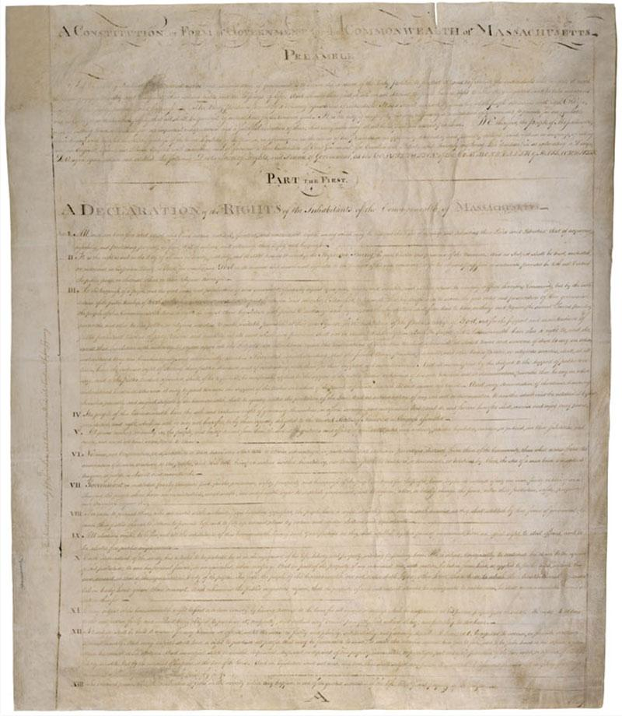
STATION 03 / PACKET PAGE 4
A FRAME FOR HISTORY
1
Measure the outside rectangle and the white window.
2
Find both areas. Subtract to find the blue mat’s area.
3
Finished? Trace a classroom pen’s flat footprint on grid paper.
INSIDE THE GOLDEN DOME
12
Notes:
Measure printed Mat3, not this projected drawing. Outer7×9cm; inner5×7cm; border28cm². The display mat is designed for this lesson. Manuscript image:https://www.sec.state.ma.us/divisions/commonwealth-museum/exhibits/treasures/constitution.htm. A classroom pen is a prop, not Healey’s actual pen. Its trace is a flat footprint, not curved surface area.

Slide 13
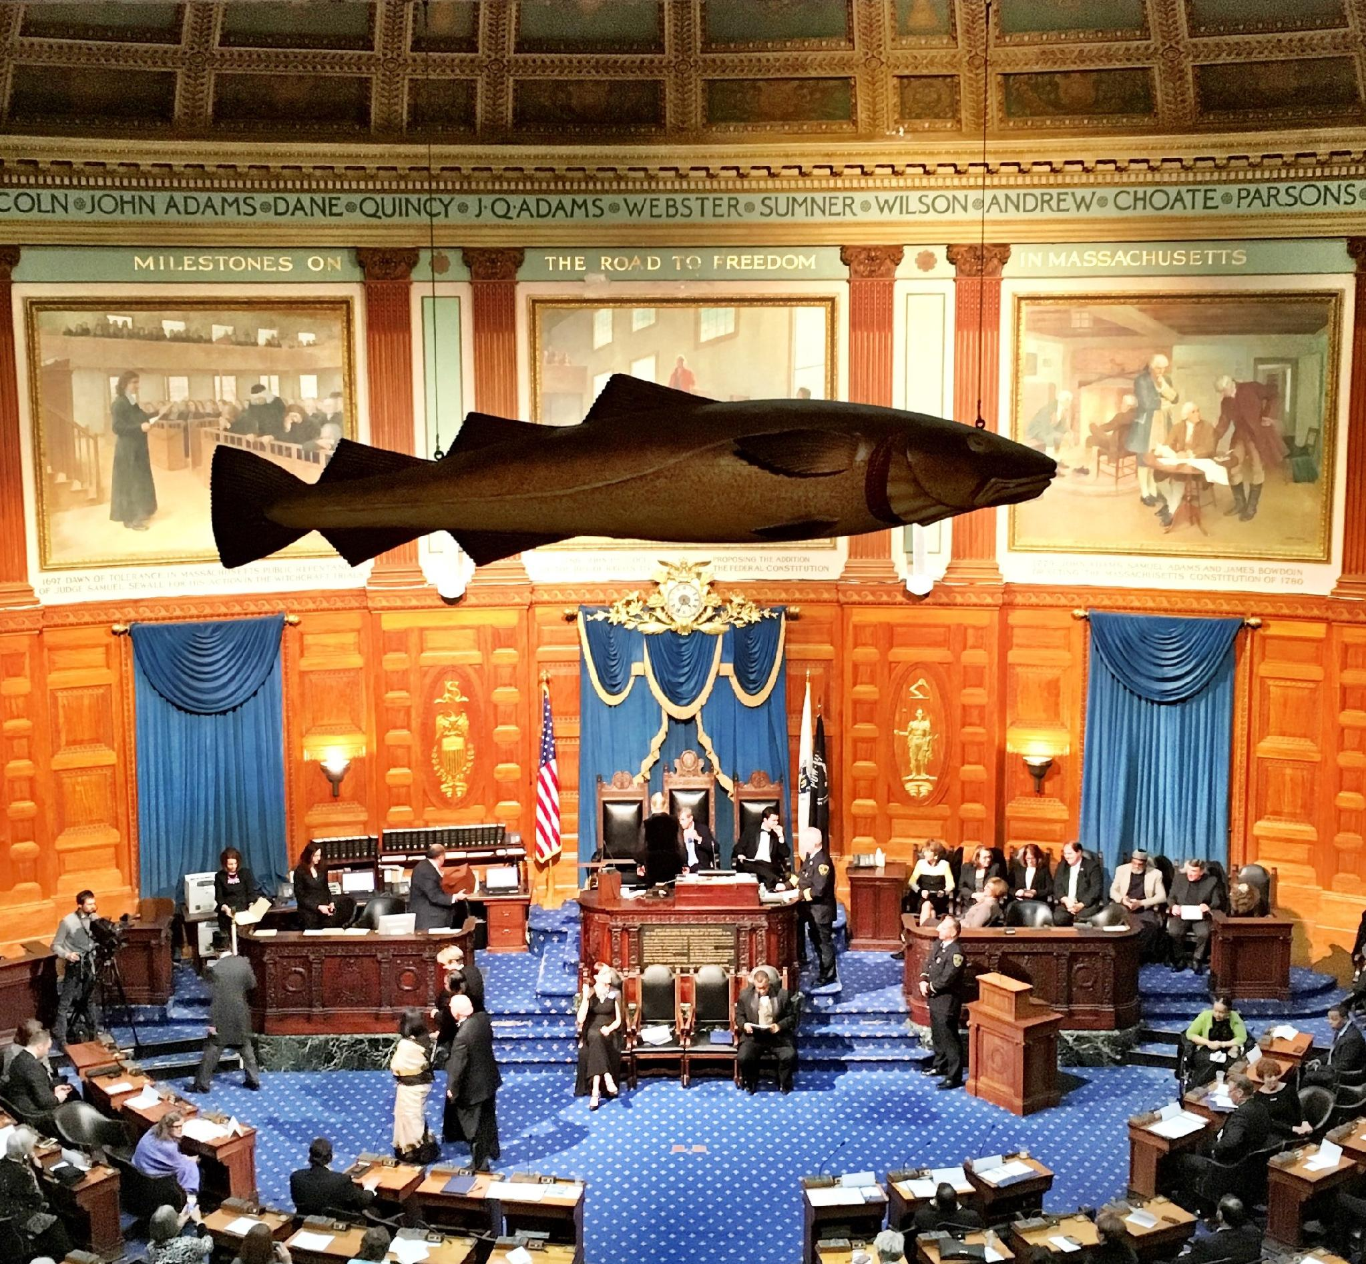
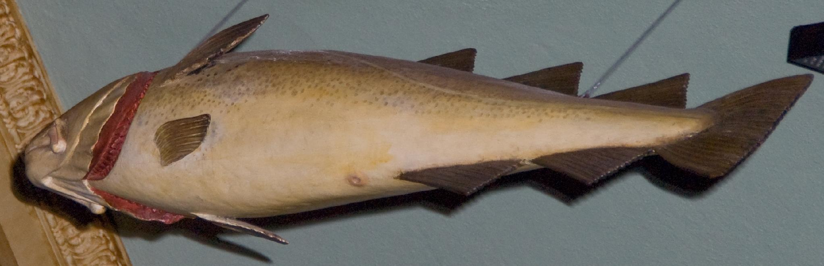
STATION 04 / PACKET PAGE 5
A FISH IN THE HOUSE
The whole grid is 12 by 4.
How much of it does the fish cover?
Count full squares.
Combine pieces along the edges.
INSIDE THE GOLDEN DOME
13
Notes:
Mat 4 now uses a 12 × 4 centimeter grid. Whole grid area: 48 cm². Reference fish silhouette: about 19 cm²; accept reasoned estimates around 16–24 cm². Leave out shadow, wires, and background. Sacred Cod facts: https://malegislature.gov/VirtualTour/FloorView?floorId=3 ; https://commons.wikimedia.org/wiki/File:The_Sacred_Cod_of_Massachusetts.jpg (Dennis Wright, CC BY 2.0). Chamber photo: Liberma, CC BY-SA 4.0, https://commons.wikimedia.org/wiki/File:Sacred_Cod_-_For_Wikipedia.jpg . Detail: Dennis Wright, CC BY 2.0.

Slide 14
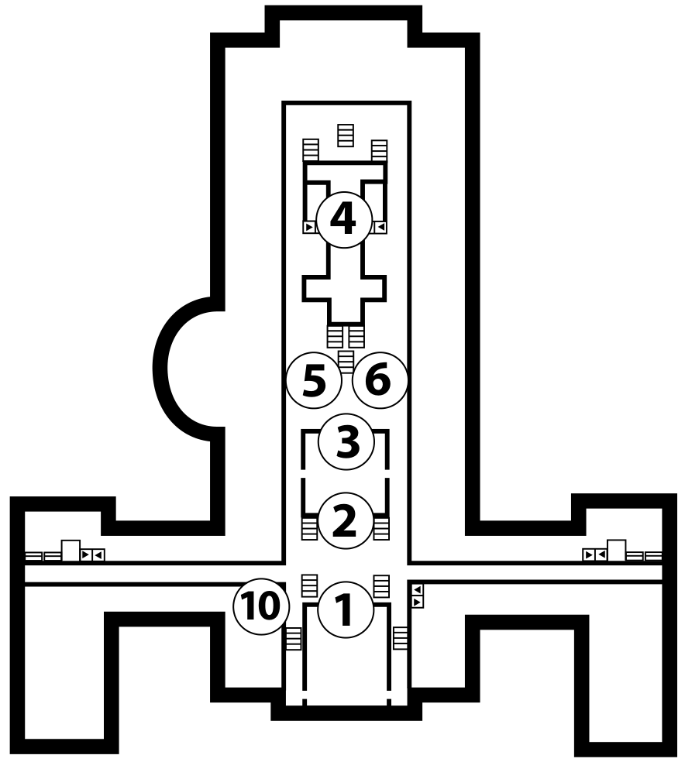
STATION 05 / PACKET PAGE 6
BLUEPRINT DETECTIVES
An 8-by-9 grid surrounds
the printed building.
Find the whole grid’s area.
Then estimate the area inside
the building’s outside outline.
What information would you need
to find the real floor area?
INSIDE THE GOLDEN DOME
14
Notes:
Mat 5 uses an 8 × 9 centimeter grid. Whole area: 72 cm². Reference printed footprint: about 37 cm²; accept careful estimates around 33–42 cm². Count walls and enclosed spaces together, not usable floor area. The official tour map gives no real-world scale. https://www.sec.state.ma.us/divisions/state-house-tours/download/self-guided.pdf

Slide 15
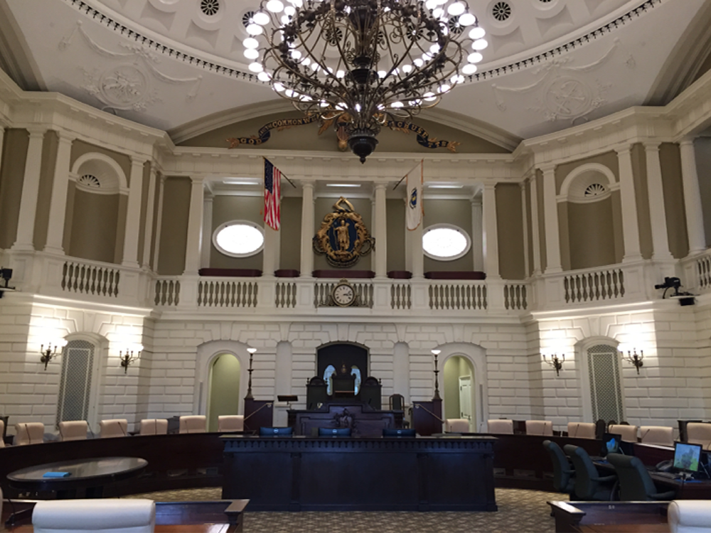
OPTION X / PACKET PAGE 8 / REPLACES STATION 5
A ROOM UNDER THE DOME
The real Senate Chamber:
55 feet × 55 feet
Model scale: 1 cm = 10 feet
Measure the model’s side.
Find its base area.
A chosen model height is 2 cm.
What is the model’s volume?
15
INSIDE THE GOLDEN DOME
15
INSIDE THE GOLDEN DOME
Notes:
Optional alternative at Station 5. Published room: 55 ft square, directly below the gold dome. https://malegislature.gov/VirtualTour/FloorView?floorId=3 . Photo: Secretary of the Commonwealth official interior gallery. Model side 5.5 cm. Base area 30.25 cm². Chosen model height 2 cm gives volume 60.5 cm³. The chosen height does not establish the real ceiling height or room volume. Bonus real square footprint: 3,025 ft².

Slide 16
STATION WORK / FIVE ROUNDS
YOUR GROUP’S INVESTIGATION
8
Reader: share the exhibit’s story.
Measurer: help use the tools.
Checker: ask “Do our units make sense?”
MINUTES PER STATION
Everyone writes in their own packet.
Switch roles at the next station.
INSIDE THE GOLDEN DOME
16
Notes:
Leave this slide projected during rotations. Start an8-minute classroom timer. Circulate first to Station2 to support square scale units. For two students combine Reader andChecker. Four1-minute transitions. If needed run the lesson in two sessions, retaining packets and group order.

Slide 17
AFTER ALL FIVE ROUNDS
EXACT ANSWERS AND ESTIMATES
EXACT FOR OUR PRINTS
REASONABLE ESTIMATES
Large flag: 60 cm²
Small flag: 15 cm²
Basketball photo: 24 cm²
Blue display mat: 28 cm²
Court print: about 45 cm²
Cod print: about 19 cm²
Map print: about 37 cm²
Why can two careful groups have different estimates?
INSIDE THE GOLDEN DOME
17
Notes:
Use after station work. Fish estimates around 16–24 cm² and map estimates around 33–42 cm² are reasonable with a clear method. Whole grids: fish 48 cm², map 72 cm². Exact and estimated refer to the printed models. Optional Senate challenge: model base 30.25 cm² and model volume 60.5 cm³. See teacher guide for complete solutions.

Slide 18
EXIT TICKET / PACKET PAGE 7 / 5 MINUTES
MY MEASUREMENT REPORT
A sign measures 8 cm × 6 cm.
A photo inside it measures 5 cm × 4 cm.
1. Find the whole sign’s area.
2. Find the area outside the photo.
3. Name one station that needed an estimate.
4. Share one fact you learned.
INSIDE THE GOLDEN DOME
18
Notes:
Independent exit ticket.48cm² whole sign;20cm² photo;28cm²outside. Fish/map requireestimatingirregularoutlines;courtusesrounding. Historicalfact responsesvary. Lookforunitsandmethodaswellasarithmetic.

Slide 19
REAL SOURCES / TEACHER REFERENCE
THE OBJECTS BEHIND THE MATH
Massachusetts Secretary of the Commonwealth
State House tour, floor plan, Constitution, and John Adams
Massachusetts Legislature
Sacred Cod, John Adams mural, and Senate dimensions
Harvard Athletics, National Governors Association, and NCAA
Healey’s biography, basketball history, and court dimensions
Clickable sources and photo credits: teacher guide, pages 6–7.
INSIDE THE GOLDEN DOME
19
Notes:
Full clickable sources and image credits are in the teacher guide, pages 6–7. Official room photos: https://www.sec.state.ma.us/divisions/state-house-tours/information/interior-photos.htm . Mural, Sacred Cod catalogue, and Senate dimensions: https://malegislature.gov/VirtualTour/FloorView?floorId=3 . House chamber photograph: Liberma, CC BY-SA 4.0, https://commons.wikimedia.org/wiki/File:Sacred_Cod_-_For_Wikipedia.jpg . Other primary sources: Secretary of the Commonwealth, Commonwealth Museum, Harvard Athletics, National Governors Association, and NCAA. All election percentages refer to the teacher-supplied interim screenshot.

